Slide 1

Kalundborg Bioenergi
Møde i partnerskab for bæredygtig bioraffinering
29-08-2023
V. Erik Lundsgaard, driftschef, Bigadan
Telefon: +45 2022 2179
E-mail: el@bigadan.dk

Slide 2
History of the Bigadan Group
“Old” Bigadan period
Krüger – Bigadan period
“New” Bigadan period
Karsten Buchhave becomes CEO and changes strategic focus from farm-based plants to large-scale biogas plants. First overseas EPC contract.
Establishment of the “new” Bigadan
Karsten Buchhave buys the Bigadan-brand
Farmatic 51 % shareholder of Bigadan
Development, Construction and
commissioning of
Kalundborg Bioenergi A/S
Krûger-Bigadan now 30 employees
Continues to work on the Bigadan platform and philosophy
Focus on large-scale co-digestion plants
Focus on MSW (Municipal Solid Waste) and export
Kruger-Bigadan good market position in Germany and Sweden
Karsten Buchhave is on the management board
Buy Herning Bioenergi
Two biogas plants
Major boost to ownership
Bigadan exceeds 1 TWh p.a. of energy production
Bigadan is founded, building standardised farm-scale biogas plants using technology available on local farms since 1978
Farmatic goes bankrupt
KB buys Farmatic shares
1982
1984
1986 - 1989
1989
1990 - 1998
1999
2000
2001
2004
2005 - 2008
2009
2010-2014
2014-2017
2020
2021
Bigadan now 10 employees
2 farm-scale AD plants
1 large scale AD plant - 40 tons/d
Karsten Buchhave employed
Buys Fangel Bioenergi ApS
Enters EPC contract for
SBS Aabenraa K/S
Value +50 mEUR
Krüger now a subsidiary in French Violia group
Krüger’s experiences low earnings
Biogas no longer core business
The entire biogas team dismissed
Steady growth in EPC contracts
mainly on export markets
Arjun Infrastructure Partners joins as a large minority shareholder
Danish companies world leaders within wind, biomass, and biogas
Bigadan is the leader in biogas technology
Krüger (large danish engineering firm) takes over Bigadan
Forms the company Krüger-Bigadan
Development, Construction and commissioning of Horsens Bioenergi ApS

Slide 3
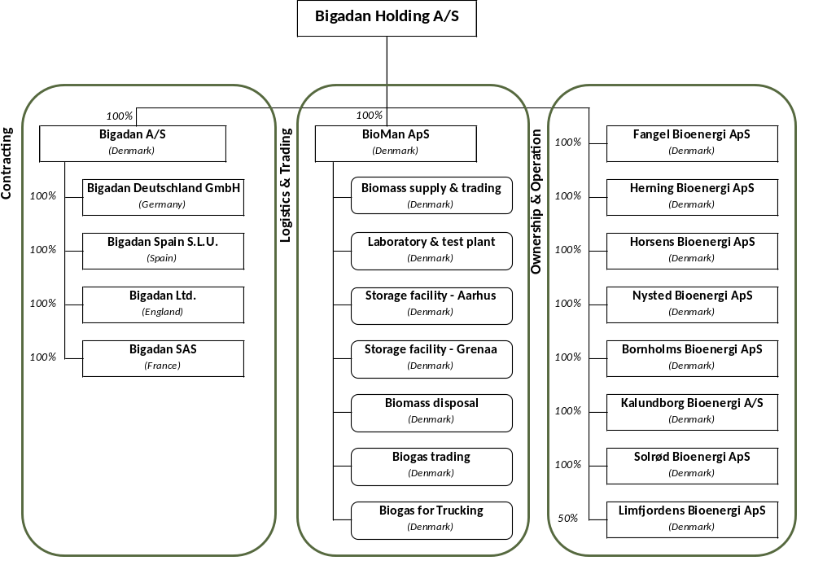
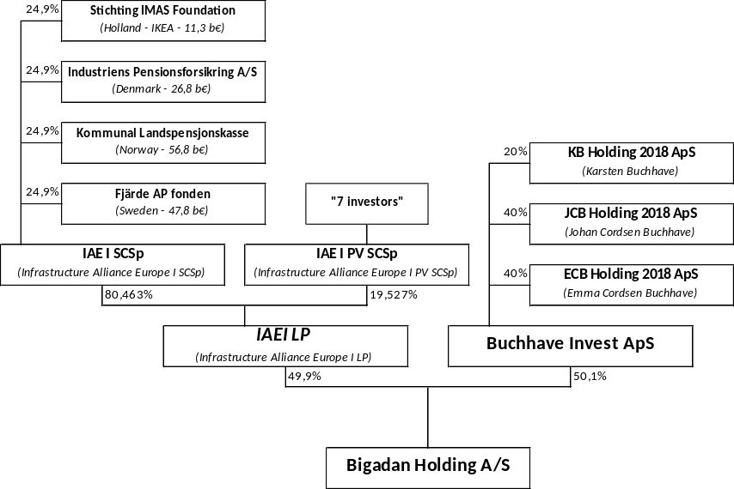
Organisation of the Bigadan Group
Strong Scandinavian investor platform

Slide 4
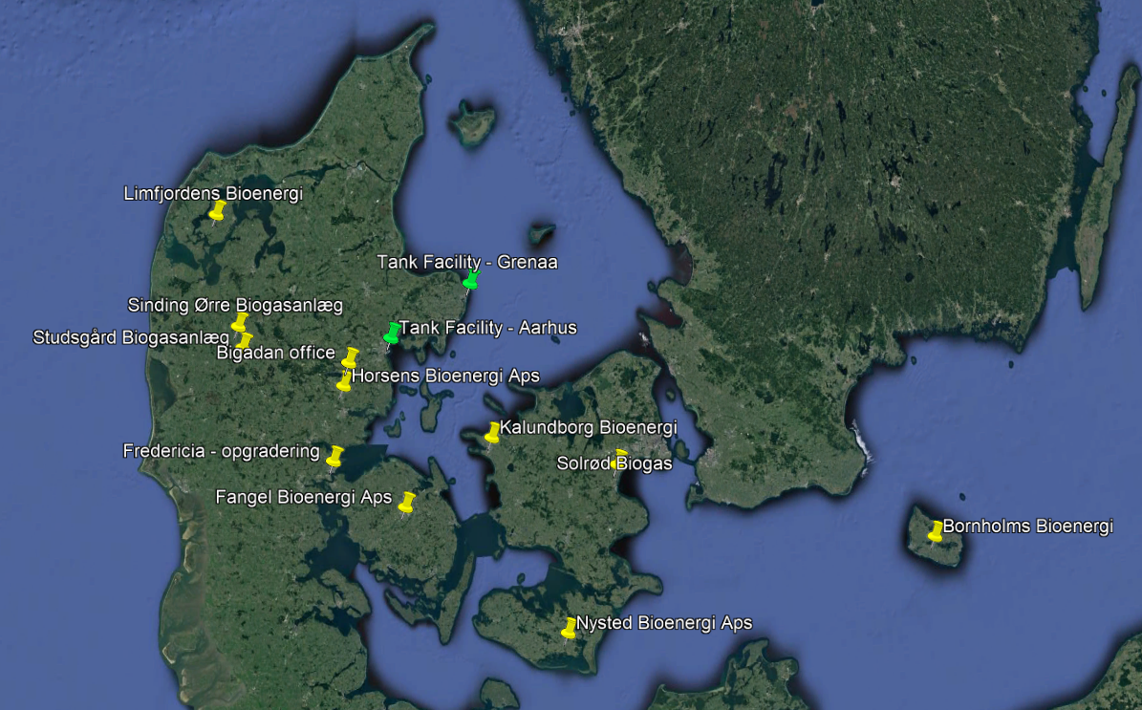
Sites of the Bigadan-group in Denmark
Ownership and/or operating
10 biogas plants in Denmark
1 in Germany

Slide 5
Organizing of Kalundborg Bioenergi
Leverandører
Biogasanlæg
Aftager
Supplier of Novoslam
(Novozymes)
Bigadan
100 %
Plant Breeders ”1”
(lokaliseret på Sydsjælland)
Supplier of Yeast cream (Novo Nordisk)
Kalundborg Bioenergi A/S
Plant Breeders ”2”
(Returkørsel fra NZFU)
Others supplier
Bioman mm.
Ørsted Energy
(Injicere biogas på naturgasnettet)

Slide 6
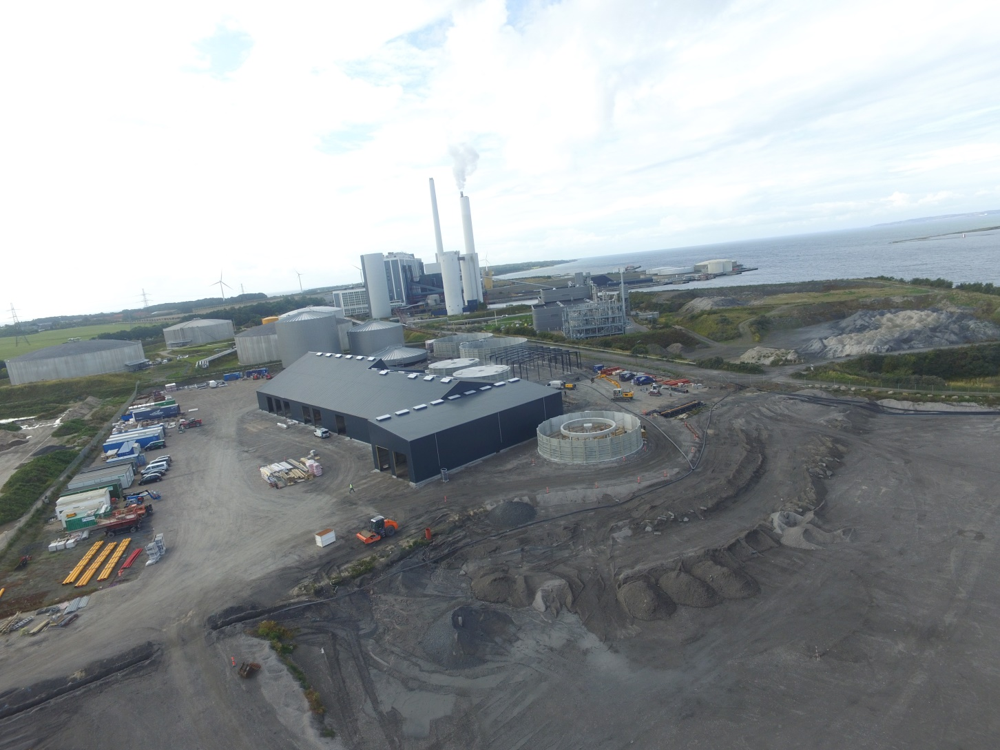
Construction status SEP 19. 2017

Slide 7
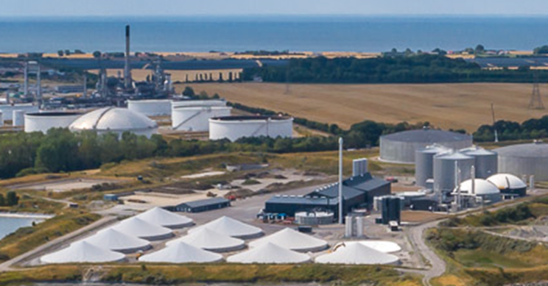
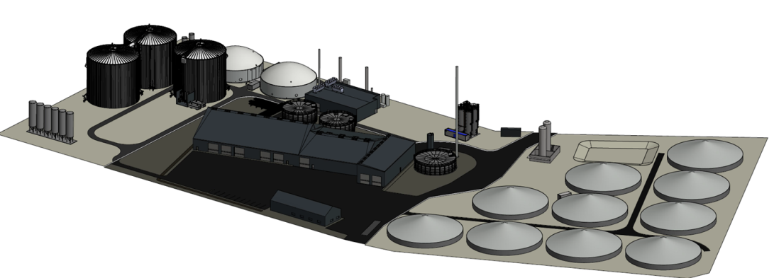
Kalundborg Bioenergi, Denmark
    Operation since April 2018
    Owned 100 % by Bigadan
    Capacity:
    400.000 t/year
    Biomass:
    Residual product from Novo Nordic and Novozymes
    Biogas production:
    30 million m³ methane/year
    Biogas utilisation:
    Gas upgrading and injection into natural gas grid
    Energy sales:
    300 GWh/year - natural gas injection

Slide 8
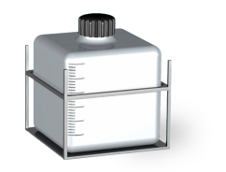
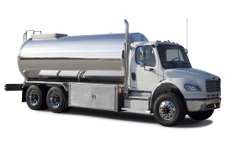
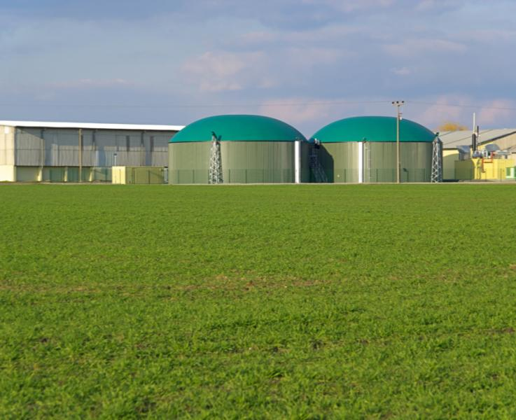
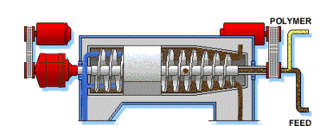
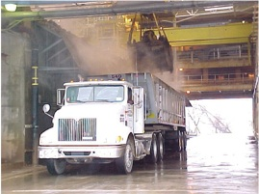
Future biomass flow
BIOMASS
DEWATERING
TRANSPORTATION
ANAEROBIC DIGESTION
BIOMASS
FROM NNKA
68,000 ton/y
DM = 16%
287,500 ton/y
42.000 ton TS (14,6% TS)
TN = 6.1 g/L
TP = 3.3 g/L
If needed, additional dilution liquid can be collected at NZKA
Gas production =
8.40 mill Nm3 CH4/y
75,000 ton/y
DM = 4%
BIOMASS FROM NZFU
BIOMASS FROM NZKA PRODUCTION AND WASTE WATER TREATMENT PLANT
150,500 ton/y
DM = 19%
FARMERS
(1 OR 2 FRACTIONS)

Slide 9
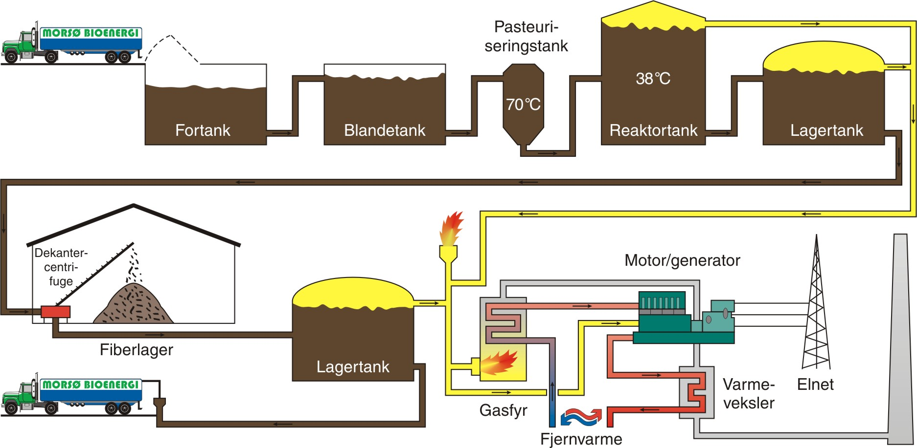
How does biogas work?

Slide 10
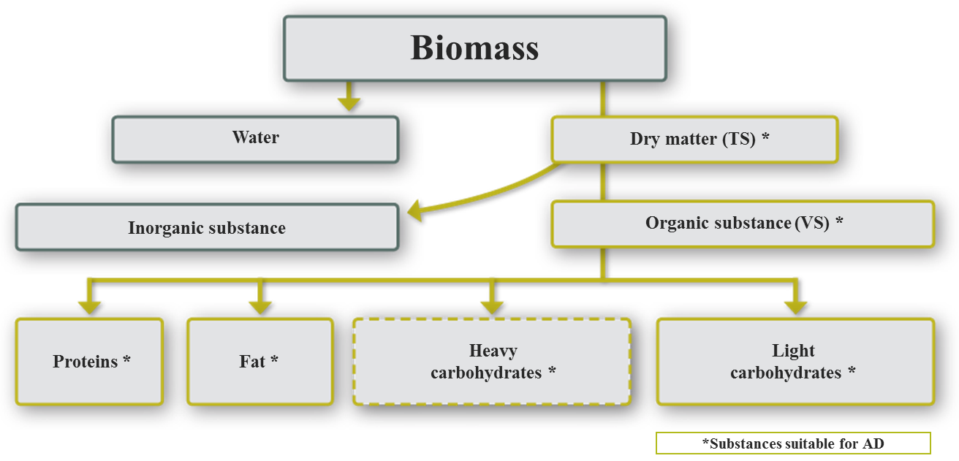
Biomass composition

Slide 11

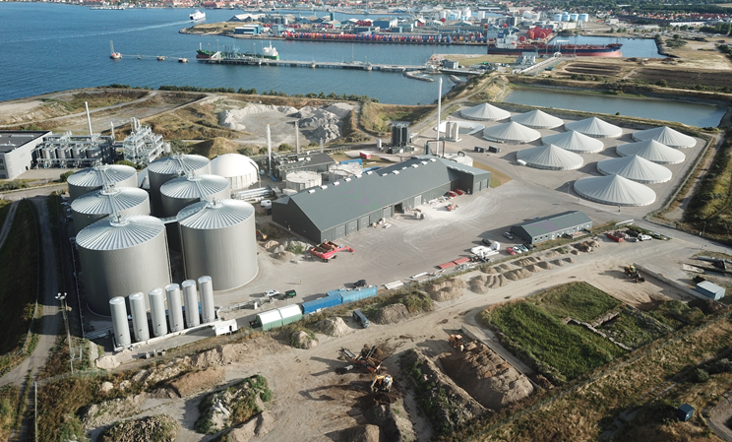
Kalundborg Bioenergi A/S
Area 52500 M2

Slide 12
Kalundborg Bioenergi A/S
Thank you for your attention.
Chef Manager
Erik Lundsgaard

